Slide 1
5 Little Monkeys
Finger Play ©By Wise Owl Factory in collaboration with Strings, Keys, and Melodies
Just keep pressing the space bar for this automatic presentation.
Notes:
By Wise Owl Factory for Strings, Keys, and Melodies, animation will show in view slide show mode but not in normal mode. Click on Slide Show, from beginning to see animation on all pages.

Slide 2
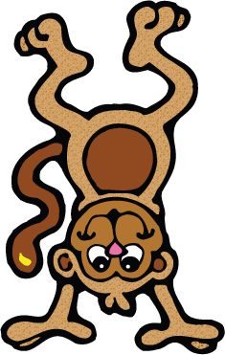
5 little monkeys jumping on the bed,
1 fell off and bumped
his head!

Slide 3
Mama called the doctor
and the doctor said,

Slide 4
“No more monkeys jumping on the bed!”

Slide 5
4 little monkeys jumping on the bed,
1 fell off and bumped
his head!

Slide 6
Mama called the doctor
and the doctor said,

Slide 7
“No more monkeys jumping on the bed!”

Slide 8
3 little monkeys jumping on the bed,
1 fell off and bumped
his head!

Slide 9
Mama called the doctor
and the doctor said,

Slide 10
“No more monkeys jumping on the bed!”

Slide 11
2 little monkeys jumping on the bed,
1 fell off and bumped
his head!

Slide 12
Mama called the doctor
and the doctor said,

Slide 13
“No more monkeys jumping on the bed!”

Slide 14
1 little monkeys jumping on the bed,
1 fell off and bumped
his head!

Slide 15
Mama called the doctor
and the doctor said,

Slide 16
“No more monkeys jumping on the bed!”

Slide 17
Graphics From the Pond http://frompond.blogspot.com
Graphics also from The Graphics Factory
Some or all of the graphics in this presentation came from Graphics From the Pond and The Graphics Factory.
It is a violation of copyright laws to remove the graphics from this presentation for other uses.
If you wish to use these graphics for yourself, you can find them by visiting http://frompond.blogspot.com and following the links provided to the graphics store.
Thank you for respecting copyright laws and the artists that created them.
Notes:
Graphics are licensed, respect copyright laws. Thank you!

