Slide 1
108學年度學生能力檢測 英語試題卷檢討

Slide 2
A. 聽力測驗 一、請仔細聽， 選出聽到的字母。

Slide 3
( )例: ① L ② H ③ F ④ A
2

Slide 4
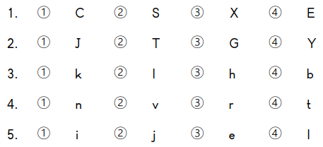
2
( )
4
( )
1
( )
3
( )
1
( )

Slide 5
A. 聽力測驗 二、請仔細聽單字， 選出空格中 應該填入的字母。

Slide 6
1
b
( )

Slide 7
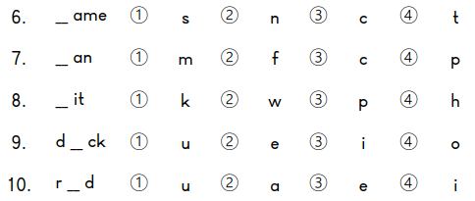
2
n
( )
3
c
( )
4
h
( )
1
u
( )
3
e
( )

Slide 8
A. 聽力測驗 三、請仔細聽單字， 選出正確的圖片。

Slide 9
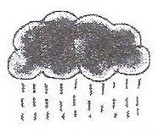
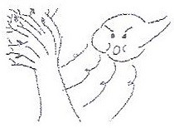
3
例: ( ) | ① | ② | ③ | ④
11. ( ) | ① | ② | ③ | ④
sunny
rainy
windy
sunny
cloudy
2
bike
car
bike
bus
taxi

Slide 10
3
12. ( ) | ① | ② | ③ | ④
13. ( ) | ① | ② | ③ | ④
grandpa
father
mother
grandpa
sister
1
living
room
kitchen
kitchen
bathroom
bedroom

Slide 11
14. ( ) | ① | ② | ③ | ④
4
dance
sing
swim
run
dance

Slide 12
A. 聽力測驗 四、請仔細聽老師所唸的 單字，先選出正確的圖片，再於下一題選出對應的單字。

Slide 13
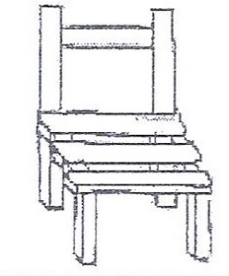
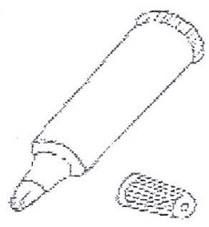
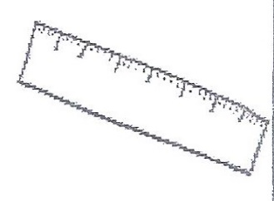
3
例: ( ) | ① | ② | ③ | ④
例: ( )
book
chair
marker
book
ruler
1
book

Slide 14
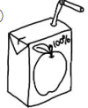
1
15. ( ) | ① | ② | ③ | ④
16. ( )
juice
juice
tea
water
milk
4
juice

Slide 15
3
17. ( ) | ① | ② | ③ | ④
18. ( )
bird
rabbit
dog
bird
cat
2
bird

Slide 16
2
19. ( ) | ① | ② | ③ | ④
20. ( )
kite
robot
kite
doll
car
4
kite

Slide 17
1
21. ( ) | ① | ② | ③ | ④
22. ( )
angry
angry
thirsty
happy
hungry
3
angry

Slide 18
A. 聽力測驗 五、請仔細聽句子或對話， 選出正確的圖片。

Slide 19
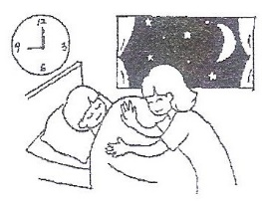
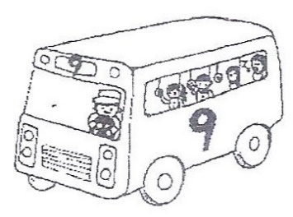
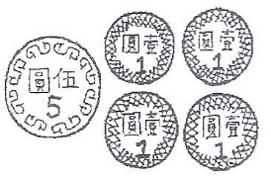
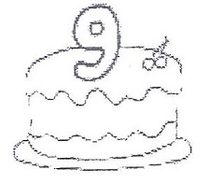
4
例: ( ) | ① | ② | ③ | ④
④ I’m nine years old.
① It’s nine o’clock.
② The number is nine.
③ I have nine dollars.

Slide 20
2
23. ( ) | ① | ② | ③ | ④
② The computer is on the desk.
① The computer is under the desk.
③ The ruler is on the desk.
④ The ruler is under the desk.

Slide 21
4
24. ( ) | ① | ② | ③ | ④
④ She is a student.
① He is a police officer.
② She is a doctor.
③ He is a teacher.

Slide 22
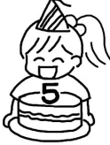
2
25. ( ) | ① | ② | ③ | ④
② I’m five.
① It’s five o’clock.
③ There are five markers.
④ I have five dollars.

Slide 23
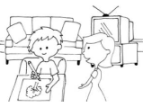
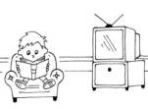
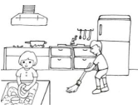
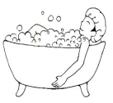
1
26. ( ) | ① | ② | ③ | ④
① They are in the living room.
② He is in the living room.
③ They are in the kitchen.
④ He is in the bathroom.

Slide 24
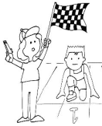
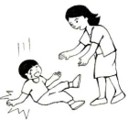
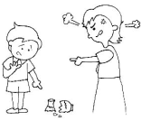
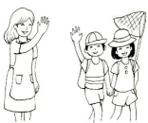
3
27. ( ) | ① | ② | ③ | ④
③ Are you ready?
① Are you OK?
② I’m sorry.
④ Goodbye.

Slide 25
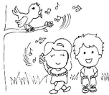
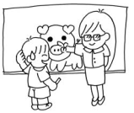
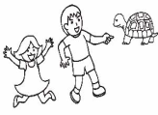
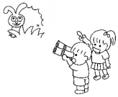
4
28. ( ) | ① | ② | ③ | ④
④ Wow! It’s a rabbit.
① Listen! The bird is singing.
② Look! It’s a pig.
③ Wow! It’s a turtle.

Slide 26
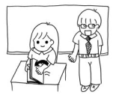
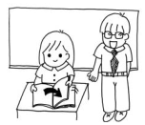
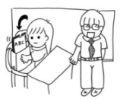
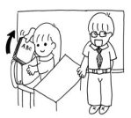
2
29. ( ) | ① | ② | ③ | ④
② A: Please open your book. B: OK.
① Please close your book.
③ Please put away your book.
④ Please take out your book.

Slide 27
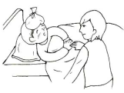
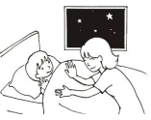
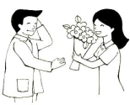
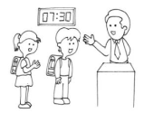
4
30. ( ) | ① | ② | ③ | ④
④ A: Good morning.
B: Good morning.
① Are you OK?
② Good night.
③ Thank you.

Slide 28
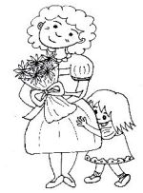
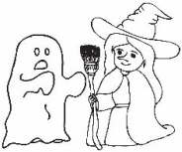
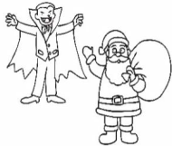
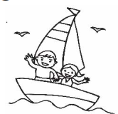
1
31. ( ) | ① | ② | ③ | ④
① A: Happy Halloween. I am a ghost.
B: Cool! I am a witch.
② Happy Mother’s Day.
③ Merry Christmas.
④ Wow! We are on the boat.

Slide 29
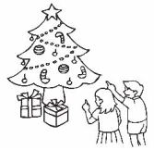
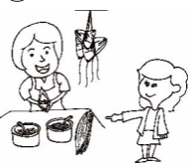
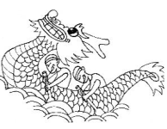
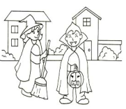
3
32. ( ) | ① | ② | ③ | ④
③ A: Look! The dragon boat race.
B: Go! Go! Go! Row the boat.
① Look! It’s a Christmas tree.
② Wow! The rice dumplings.
④ Trick or treat. Happy Halloween.

Slide 30
A. 聽力測驗 六、請仔細聽問句， 選出最適當的答句。

Slide 31
例:( )① No, it isn’t. ② It’s hot. ③ Yes, I am. ④ He’s not Tom.
1
Q: Is this a robot?

Slide 32
33.( )① I want a ball. ② I like yellow. ③ I am sleeping. ④ I am sad.
1
Q:What do you want?

Slide 33
34.( )① I’m fine. ② I have a clock. ③ They’re clocks. ④ It’s five.
4
Q: What time is it?

Slide 34
35.( )① Yes, you are. ② Yes, I am. ③ No, I am not a teacher. ④ No, you are not a student.
2
Q: Are you a student?

Slide 35
36.( )① It’s in the bedroom. ② It’s my kite. ③ I want a kite. ④ I am at home.
1
Q: Where’s the kite?

Slide 36
37.( )① She can draw. ② He’s my grandpa. ③ He can draw. ④ He’s drawing.
3
Q: What can your grandpa do?

Slide 37
B. 閱讀測驗 七、請仔細看圖片， 選出最適當的單字。

Slide 38
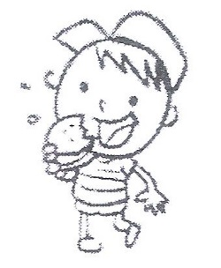
1
例: ( ) |  | ① eat ② like ③ read ④ want
<吃>
<喜歡>
<閱讀>
<想要>

Slide 39
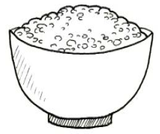
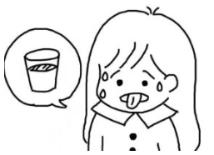
1
38. ( ) |  | ① rice ② cake ③ fish ④ pizza
<米飯>
<蛋糕>
<魚>
<披薩>
3
39. ( ) |  | ① happy ② hungry ③ thirsty ④ angry
<快樂的>
<飢餓的>
<口渴的>
<生氣的>

Slide 40
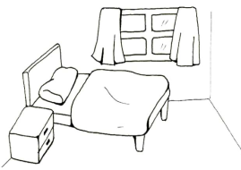
2
40. ( ) |  | ① ruler ② pen ③ pencil ④ eraser
<直尺>
<筆>
<鉛筆>
<擦布>
4
41. ( ) |  | ① bathroom ② living room ③ kitchen ④ bedroom
<浴室>
<客廳>
<廚房>
<房間>

Slide 41
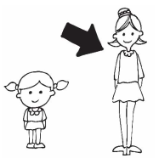
1
42. ( ) |  | ① tall ② small ③ short ④ big
<高的>
<小的>
<矮的>
<大的>
43. ( ) |  | ① dance ② read ③ write ④ draw
4
<跳舞>
<閱讀>
<書寫>
<畫畫>

Slide 42
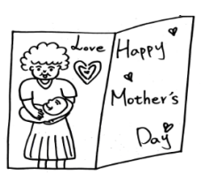
3
44. ( ) |  | ① flower ② boat ③ card ④ star
<花>
<船>
<卡片>
<星星>
2
45. ( ) |  | ① Christmas tree ② candy cane ③ Santa Claus ④ dragon boat
<聖誕樹>
<拐杖糖>
<聖誕老人>
<龍舟>

Slide 43
B. 閱讀測驗 八、請仔細看圖片， 選出最符合圖意的句子。

Slide 44
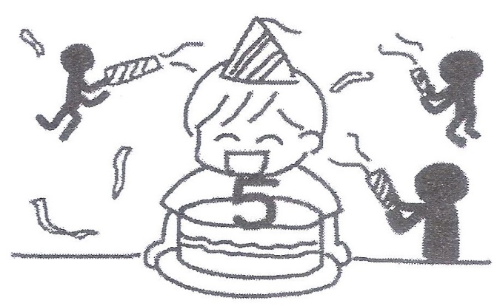
1
例: ( ) | ① I’m happy. ② I’m sad. ③ I’m angry. ④ I’m tired.
<我很開心>
<我很傷心>
<我很生氣>
<我很累>

Slide 45
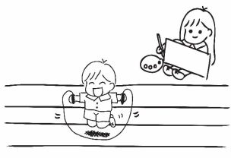
1
46. ( ) | ① He is jumping. ② She is running. ③ He is swimming. ④ She is dancing.
<他正在跳>
<她正在跑步>
<他正在游泳>
<她正在跳舞>

Slide 46
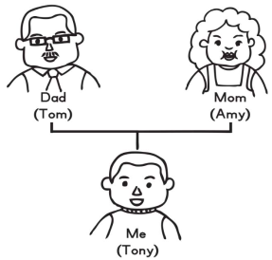
4
47. ( ) | ① My name is Tom. ② Tom is my grandpa. ③ Amy is my sister. ④ Amy is my mother.
<我是Tom >
< Tom是我的祖父 >
< Amy是我的姊姊 >
< Amy是我的媽媽 >

Slide 47
3
48. ( ) | ① That is a ruler. ② This is a marker. ③ This is a pencil. ④ That is a pencil.
<那是一支直尺>
< 這是一支馬克筆>
<這是一支鉛筆>
<那是一支鉛筆>

Slide 48
B. 閱讀測驗 九、請仔細讀下面的問句或短文， 選出最適當的答案。

Slide 49
4
例: ( ) | Where are you?
 | ① I’m happy. ② I’m fine. ③ I’m a student. ④ I’m in the living room.
<我很開心>
<我很好>
<我是一個學生>
<我在客廳裡>

Slide 50
2
49. ( ) | What are you doing?
 | ① He’s drawing. ② I’m eating. ③ She’s writing. ④ You are dancing.
<他正在畫畫>
<我正在吃>
<她正在寫字>
<你正在跳舞>

Slide 51
3
50. ( ) | What’s this?
 | ① It’s on the chair. ② I want a marker. ③ It’s an eraser. ④ It’s sunny.
<它在椅子上>
<我想要一支馬克筆>
<它是一個擦布>
<天氣是晴朗的>

Slide 52
2
51. ( ) | How’s the weather?
 | ① It’s seven. ② It’s hot. ③ It’s green. ④ It’s tall.
<現在是七點鐘>
<天氣是炎熱的>
<它是綠色的>
<它很高>

Slide 54
1
52.( ) | Where is Ivy? ① She’s at home. ② She’s at school. ③ She’s at the zoo. ④ She’s in the park.

Slide 55
3
53.( ) | Who is Ivy? ① She’s Kenny’s mom. ② He’s Kenny’s dad. ③ She’s Kenny’s sister. ④ She’s Kenny’s teacher.

Slide 56
4
54.( ) | What is Ivy doing? ① She’s playing. ② She’s running. ③ She’s singing. ④ She’s sleeping.

