Slide 1
-110畢業系列活動-
六年級
英語自我介紹

Slide 2
六年級英語自我介紹
Self-Introduction
1. 休業式前，完成英語自我介紹內容
2. 寒假期間，每天念稿3次練習
3. 1/26 開始背稿
4. 2/11 開學後驗收
5. 3/1(二)~3/8(二)進行英語自我
介紹認證活動

Slide 3
Time to introduce yourself.

Slide 4
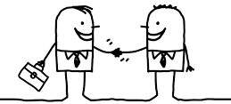
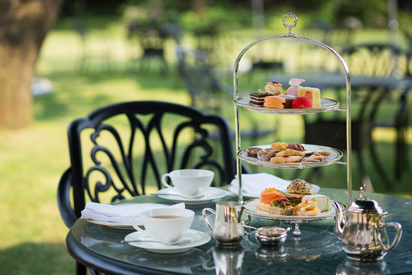
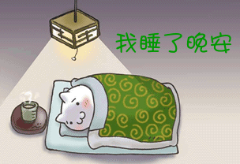
1-1. Greeting (打招呼)
Good morning. (早安)
Good afternoon. (午安)
Good night. (晚安)

Slide 5
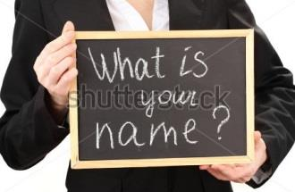
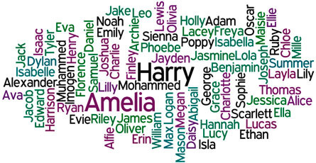
1-2. Name(姓名)
My name is .

Slide 6
1-3. Age(年紀)
I’m years old.

Slide 7
1-4. Nationality(國籍)
I’m from .

Slide 8
Let’s Practice!
1-1. Good .
1-2. My name is .
1-3. I’m years old.
1-4. I’m from .

Slide 9
2-1. Transportation(交通工具)
I go to school ______________ every day.
by car
on foot
by scooter

Slide 10
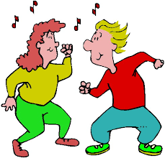
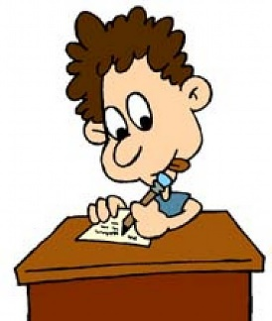
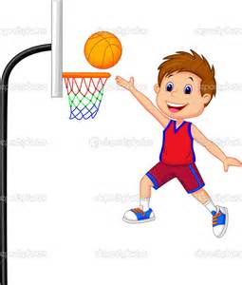
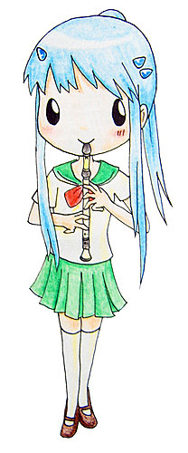
2-2. Specialty(專長)
I’m good at .
singing
dancing
drawing
writing
swimming
playing the recorder
吹直笛
playing basketball

Slide 11
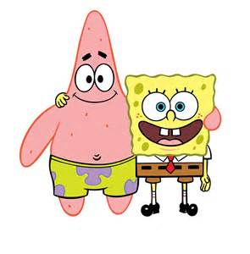
2-3. Friend(朋友)
At school, my best friend is .

Slide 12
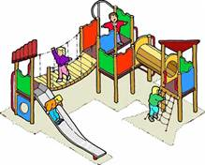
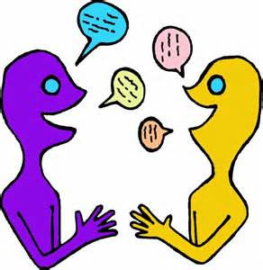
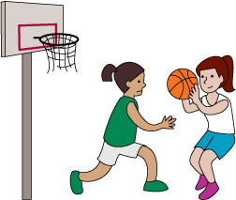
2-4. Friend(朋友)
We like to together.
play
talk
read
run
play basketball
do homework

Slide 13
Let’s Practice!
2-1. I go to school ________ every day.
2-2. I’m good at .
2-3. At school,
my best friend is .
2-4. We like to together.

Slide 14
3-1. Homework Time (作業時間)
When I’m at home,
I do my homework at _____________.
7:00

Slide 15
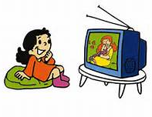
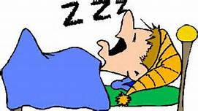
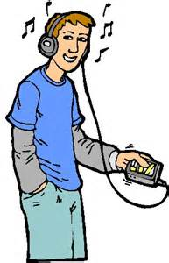
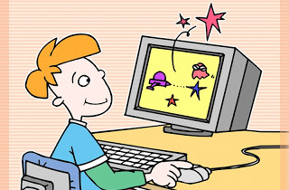
3-2. Hobby(興趣)
I like to .
on Saturdays and Sundays.
watch TV
read
sleep
listen to music
play computer games

Slide 16
3-3. Countries(國家)
My favorite country is .
Taiwan
the USA
the UK
Japan
Korea
Australia

Slide 17
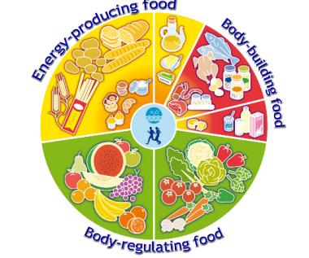
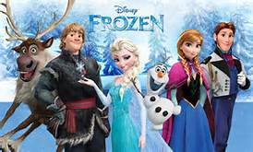
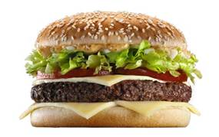
3-4. Things I Like(喜歡的事物)
And my favorite ① is ② .
①
book
song
movie
food
②
Harry Potter
Jingle Bell Rock
Frozen
hamburger

Slide 18
Let’s Practice!
3-1. When I’m at home,
I do my homework at _______.
3-2. I like to ________________
on Saturdays and Sundays.
3-3. My favorite country is .
3-4. And my favorite ① is ② .

Slide 19
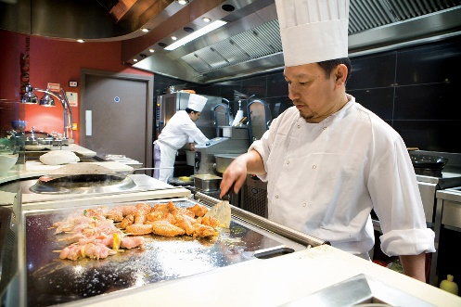
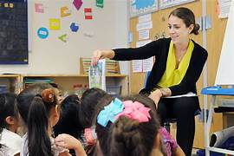
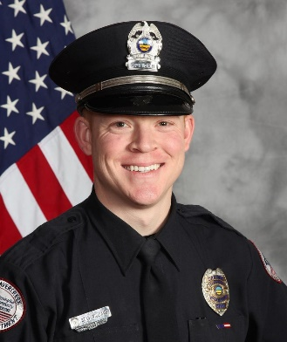
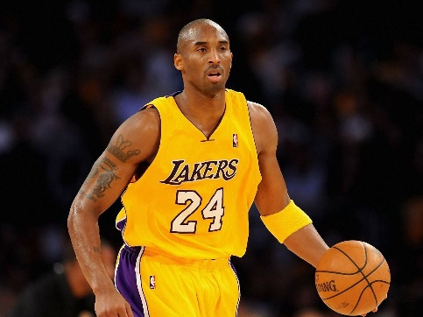
4-1. Job(工作)
In the future, I want to be a/an ___________.
doctor
nurse
cook
teacher
hair dresser
singer
police officer
basketball
player

Slide 20
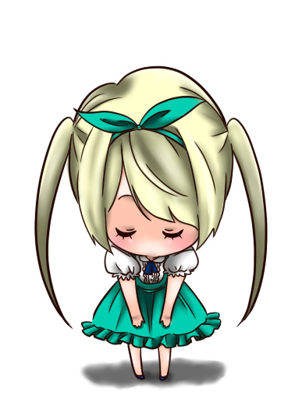
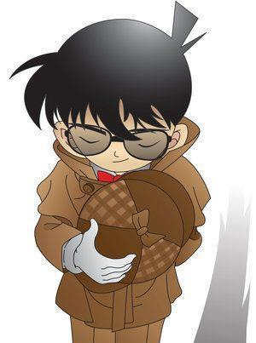
4-2. Ending(結尾)
Thank you very much.

Slide 21
Let’s Practice!
4-1. In the future, I want to be
a/an .
4-2. Thank you very much.

Slide 22
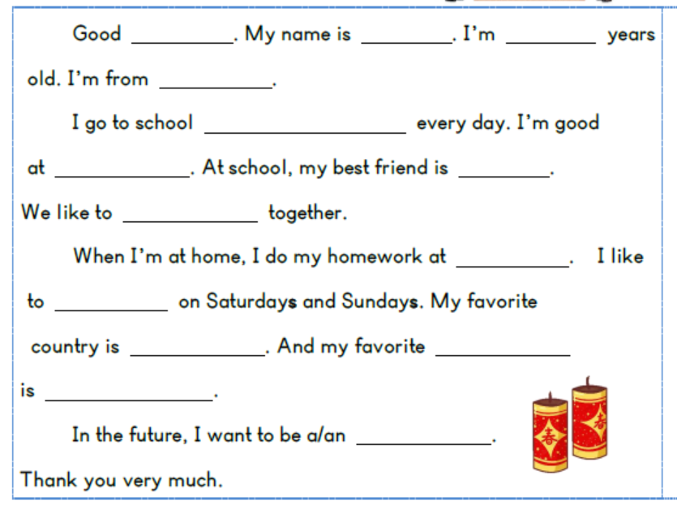

Slide 23
The end. ☺

