Slide 1
Unit 1 & Unit2

Slide 2
Sentence patterns
Where are you going?
I am going to the ________.
Where is he/ she going?
He/ She is going to the _______.
Where are you/ they going?
We/ They are going to the _________.

Slide 3
Sentence patterns
Are you going to the park?
Yes, I am. (Yes, I’m. ???)
No, I am not. I’m going to the _________.
Is he/ she going to the park?
Yes, he/ she is.
No, he/ she isn’t. He/ She is going to the _______.
練習: Are they going to the park?

Slide 4
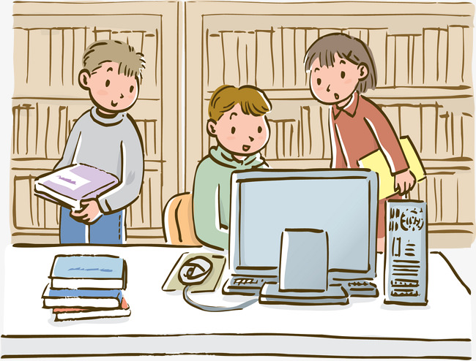
Words

Slide 5
Words

Slide 6
Sentence patterns
What do you see?
I see a bear.
I see three bears./ I see some bears.
How many bears are there?
There is one/ a bear.
There are three bears.

Slide 7
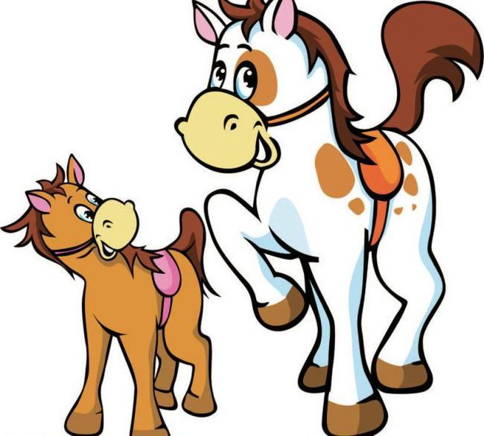
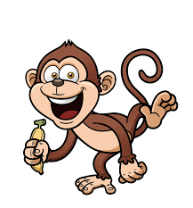
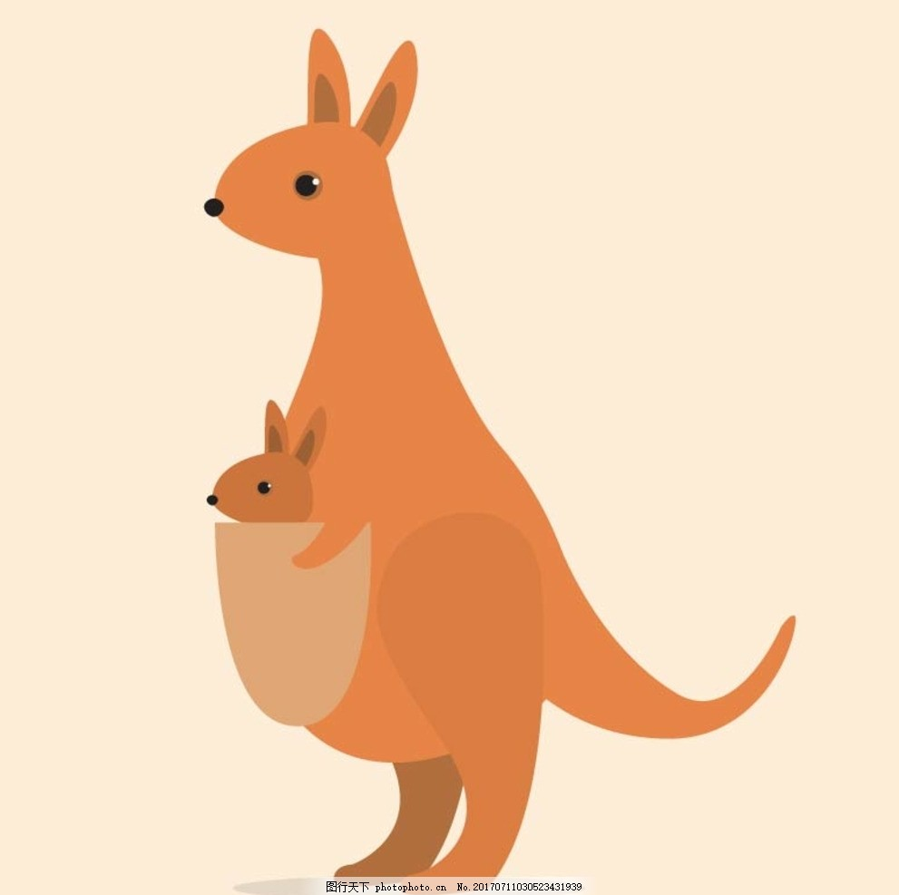
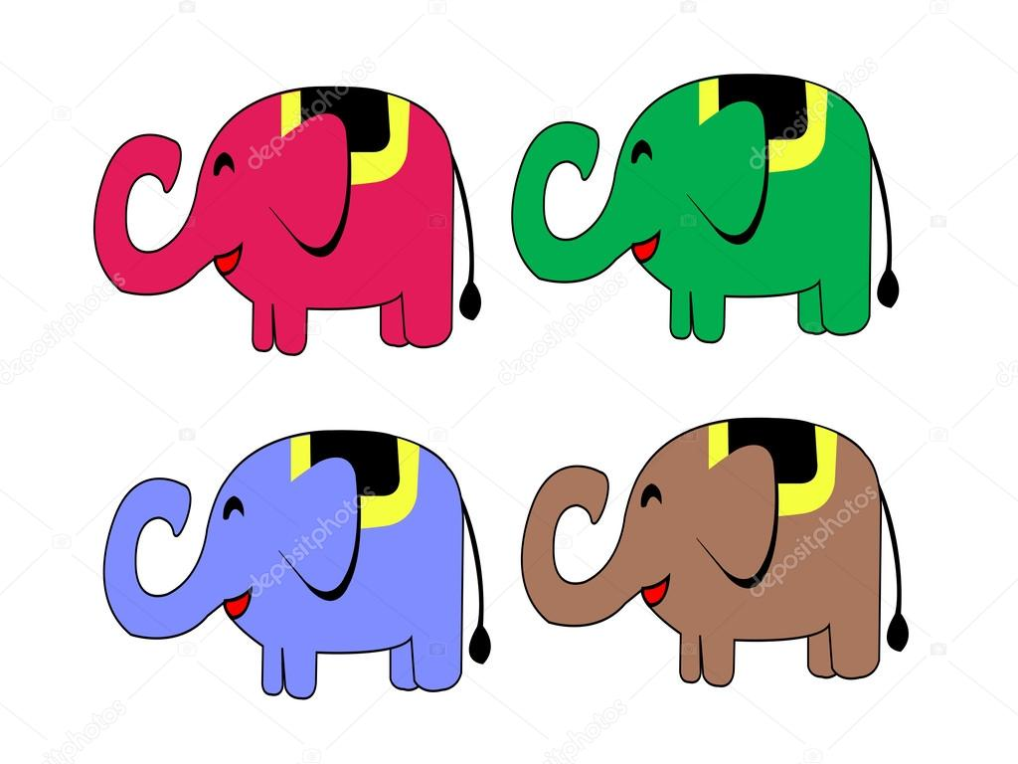
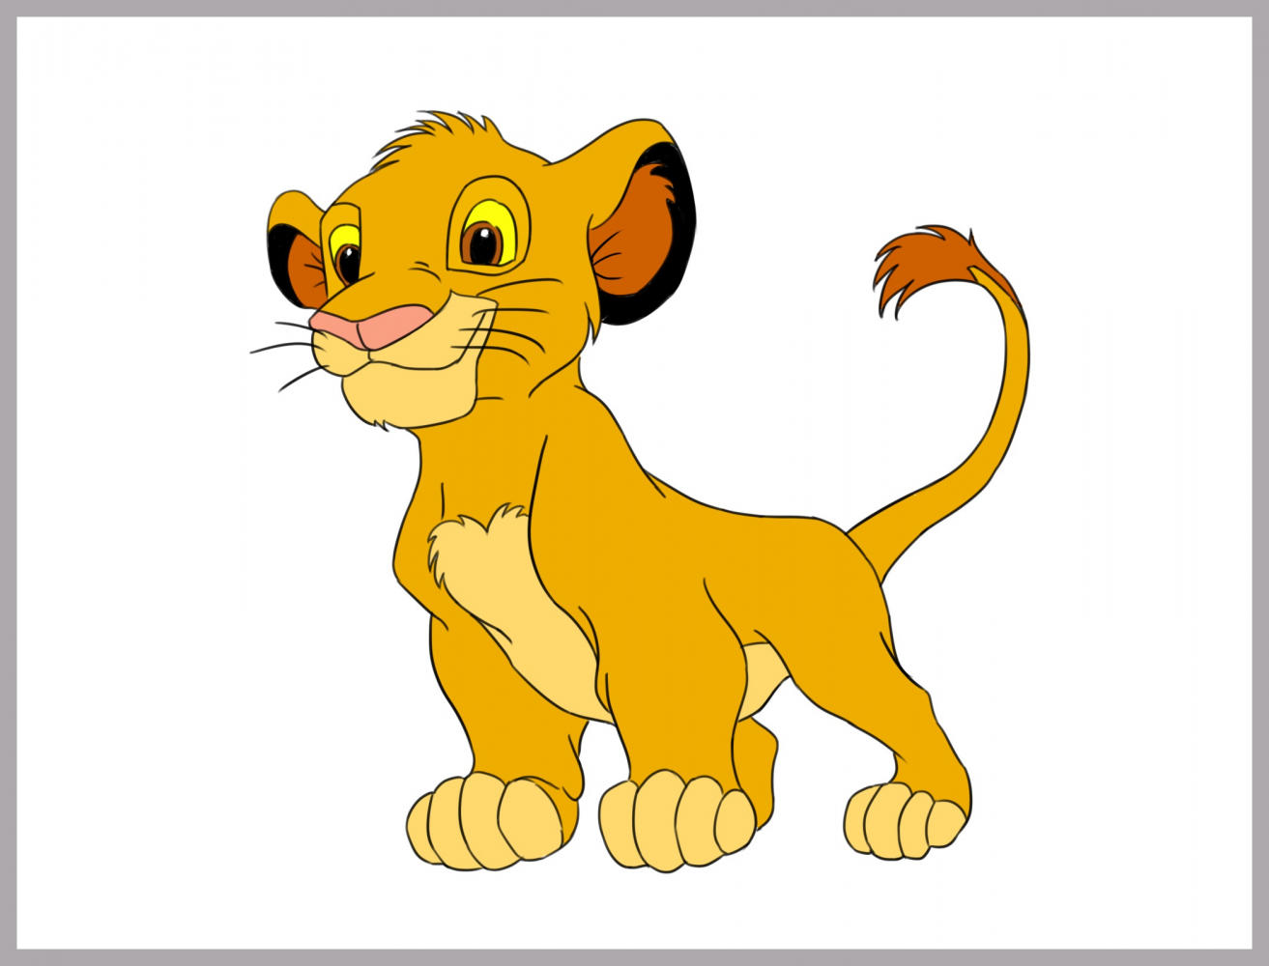
Sentence pattern

Slide 8
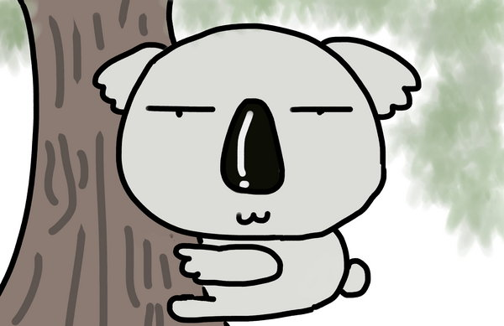
words

