Slide 1
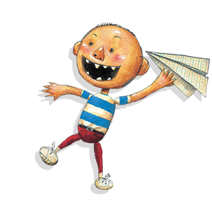
David Gets in Trouble

Slide 2
mom

Slide 3
dad

Slide 4
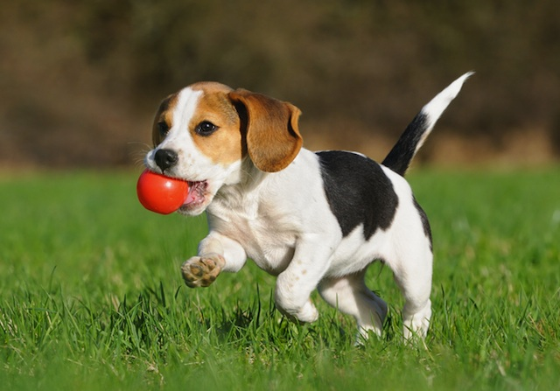
dog

Slide 5
homework

Slide 6
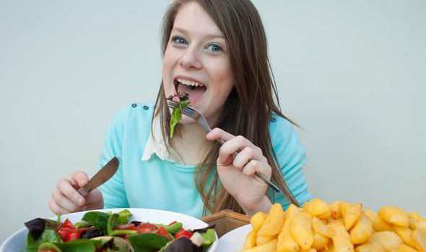
ate

Slide 7
likes

Slide 8
says

Slide 9
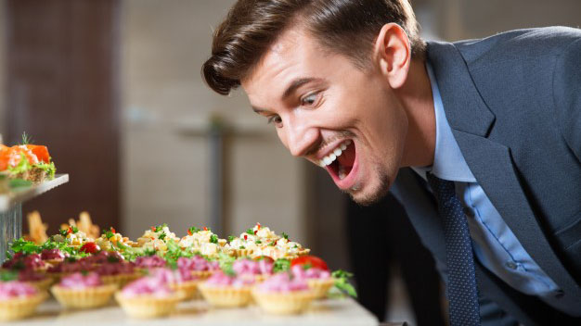
hungry

Slide 10
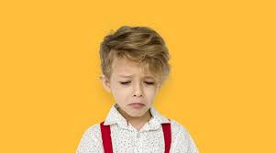
sorry

Slide 11
I SPY
LETTERS FUN

Slide 12
dog
sorry
hungry
ate
mom
homework
dad
says
likes
dog
mom
dad
dog
Notes:
T: I spy 8 small os. Can you find them?
T: I spy 1 small n. Can you find it?

Slide 13
DOG
HOMEWORK
DAD
SORRY
LIKES
ATE
HUNGRY
MOM
SAYS
HOMEWORK
HUNGRY
Notes:
T: I spy 2 big Ns. Can you find them?
T: I spy 7 big Os. Can you find them?

Slide 14
dog
sorry
hungry
ate
mom
homework
mom
says
likes
dad
mom
Notes:
T: I spy 2 words that start with the letter D. Can you find them?
T: I spy 3 matching words. What word is it?

