Slide 1
Unit 3
Transportation
本教學PPT內的圖片及歌曲來源為網路及YouTube，僅供教學使用，請尊重著作權，以免觸法。

Slide 2
Lesson Two

Slide 3
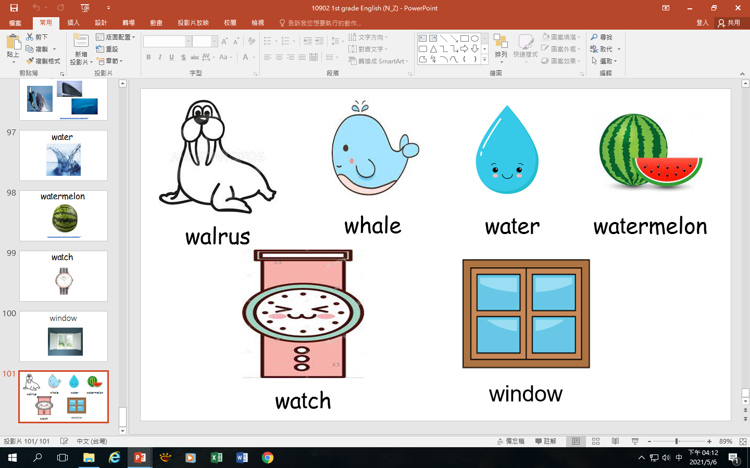
W w

Slide 4
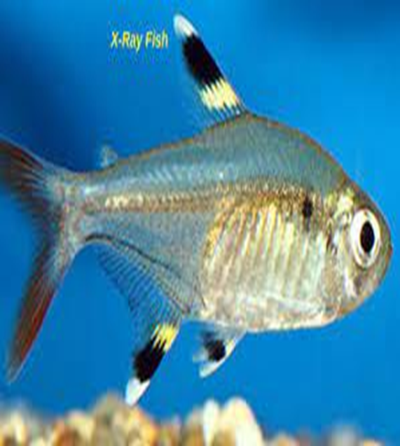
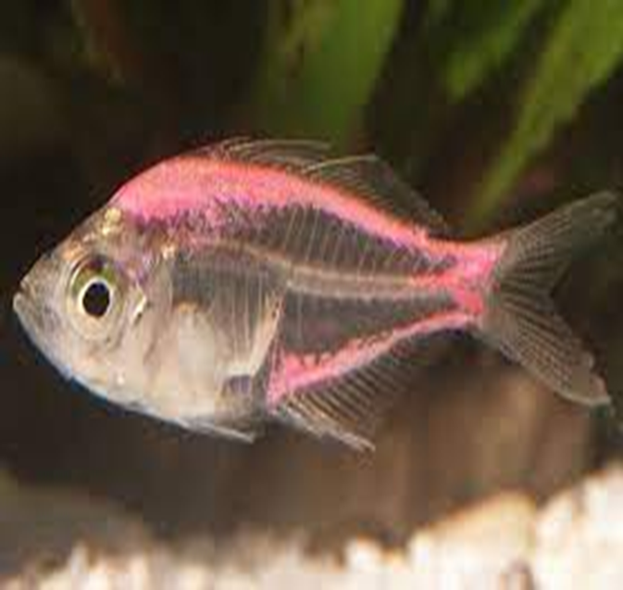
X x

Slide 5
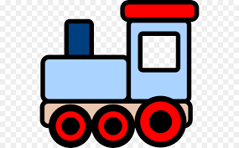
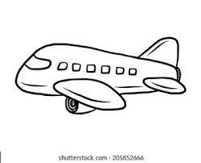
bike
bus
car
train
plane
rocket

Slide 6
Transportation Action Song - The Singing Walrus - Actions by Mike's home
YouTube:
https://www.youtube.com/watch?v=H6hkqdoZTqg

Slide 7
traffic light (紅綠燈)

Slide 8
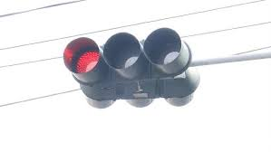
red light (紅燈)

Slide 9
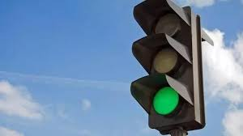
green light (綠燈)

Slide 10
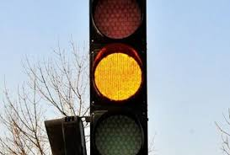
yellow light (黃燈)

Slide 11
Songs
https://www.youtube.com/watch?v=I2guwOzXDIM (先聽這首歌熟悉紅綠燈的三個顏色)
https://www.youtube.com/watch?v=YdG-tOtpyM0 (接著聽這首歌，練習聽和說 “紅綠燈”及 “紅、綠、黃燈”。也可以一起和影片的小朋友們一起動一動喔!)

Slide 12
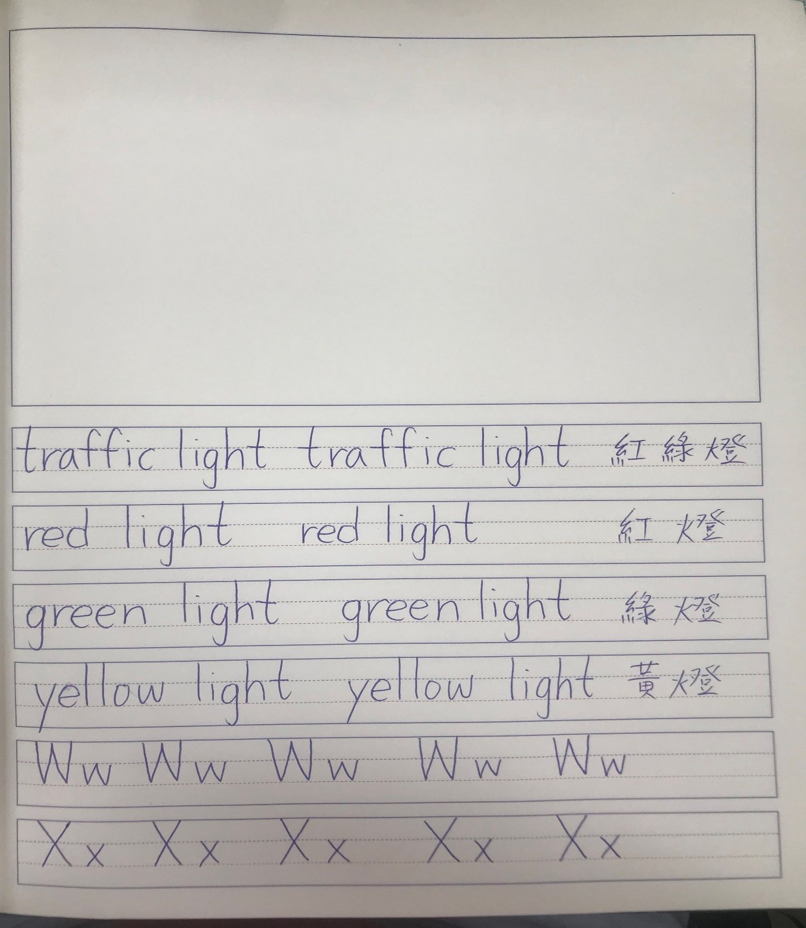
Homework (功課)
traffic light 紅綠燈
red light 紅燈
green light 綠燈
yellow light 黃燈
1~4(2次)
------------------------------------------------------------------------------------------
5. W w
6. X x
5~6 (5次)

